Slide 1
Recycle 1
五年级

Slide 2






February
January
March
April
May
June

Slide 3






July
August
September
October
November
December

Slide 4
Show time
例 句
A: What’s your favourite season?
B: Spring.
A: When is spring?
B: It’s in March, April and May.
A: What do you often do in spring?
B: I often plant trees in spring.

Slide 5

Let’s learn
When is Mid-autumn Day?
It’s on August 15th.

Slide 6
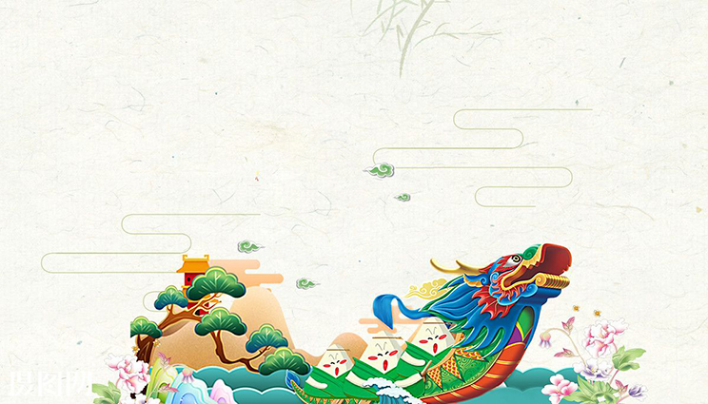
Let’s learn
When is Dragon Boat Festival?
It’s on May 5th.

Slide 7
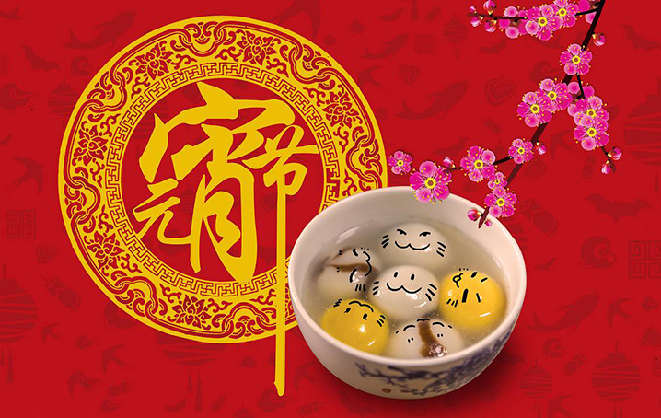
Let’s learn
When is Lantern’s Day?
It’s on January 15th.

Slide 8

Let’s learn
When is April Fool’s Day?
It’s on April 1st.

Slide 9

Let’s learn
When is mother’s Day?
It’s on May 11rd.
每年五月的第二个星期日

Slide 10

Let’s learn
When is Father’s Day?
It’s on June 15th.
每年六月的第三个星期日

Slide 11
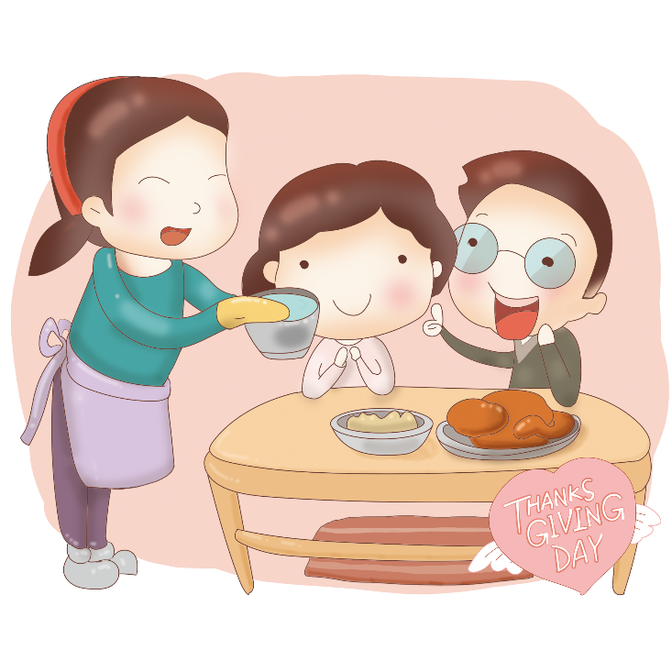
Let’s learn
When is Thanksgiving Day?
It’s on November 22nd.
每年11月的第四个星期四

Slide 12
Teacher’s day 5.1
Children’s Day 10.1
Christmas Day 1.1
Women’s Day 3.12
Army Day 9.10
National Day 8.1
New Year’s Day 6.1
Labour Day 3.8
Tree-planting Day 12.25

Slide 13
Mid – autumn Day 11.1
Dragon Boat Festival 7.4
Lantern’s Day 5.5
Easter Day(4.8) 8.15
April Fool’s 1.15
Mother’s Day(5.13) 2.14
Father’s Day(6.17) 4.1
Independence Day 每年春分月圆之后的第一个星期日
Halloween 每年十一月的第四个星期四
Valentine’s Day 每年六月的第三个星期日
Thanksgiving Day(11.22) 每年五月的第二个星期日

Slide 14
Sarah will visit Sydney in April. She asks Stella, a friend there ,about the weather. Read the Stella's reply on page 34 and answer the under question.
Read and answer.
1.Is it spring in Sydney in April?
2.What's the weather like in April in Sydney?

Slide 15
Pronunciation
cl /k/ clean clock class clever
pl /pl/ plate eggplant please play
gr /gr/ great green grow grass
br /br/ brown library brother
ch /t∫/ cheap chair chip check
sh /∫/ shoulder sheep ship shop

Slide 16
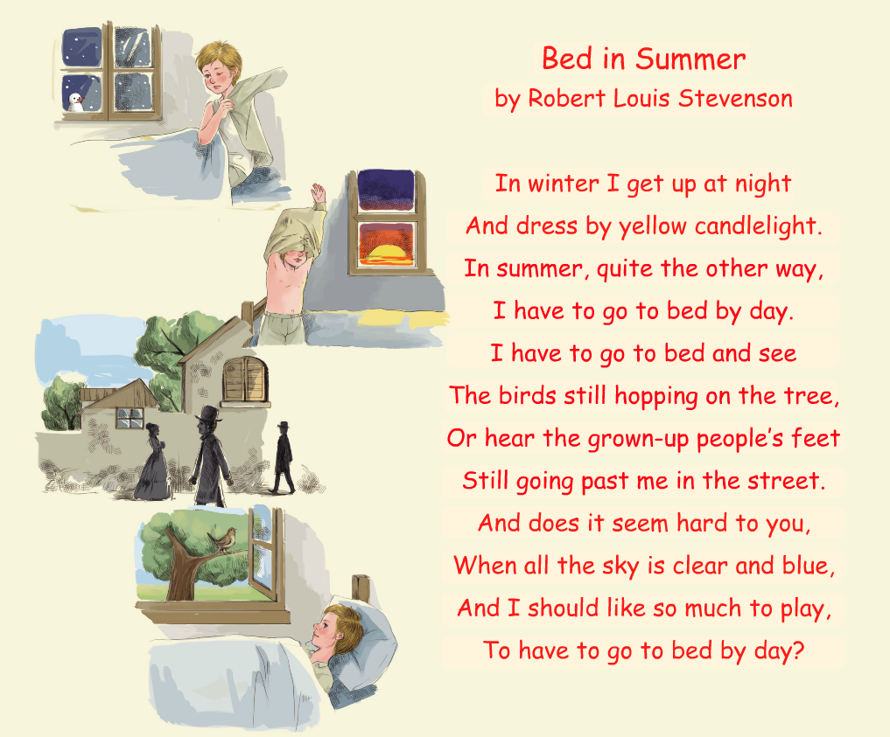
Sarah often reads to Sam. This is a poem that Sarah will read today.

Slide 17
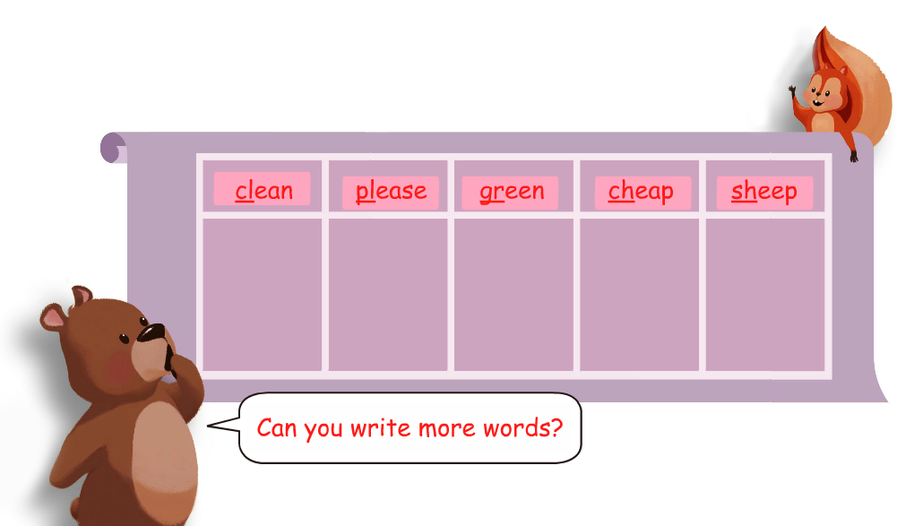
Find "friends" in the poem for the words below.

